Slide 1
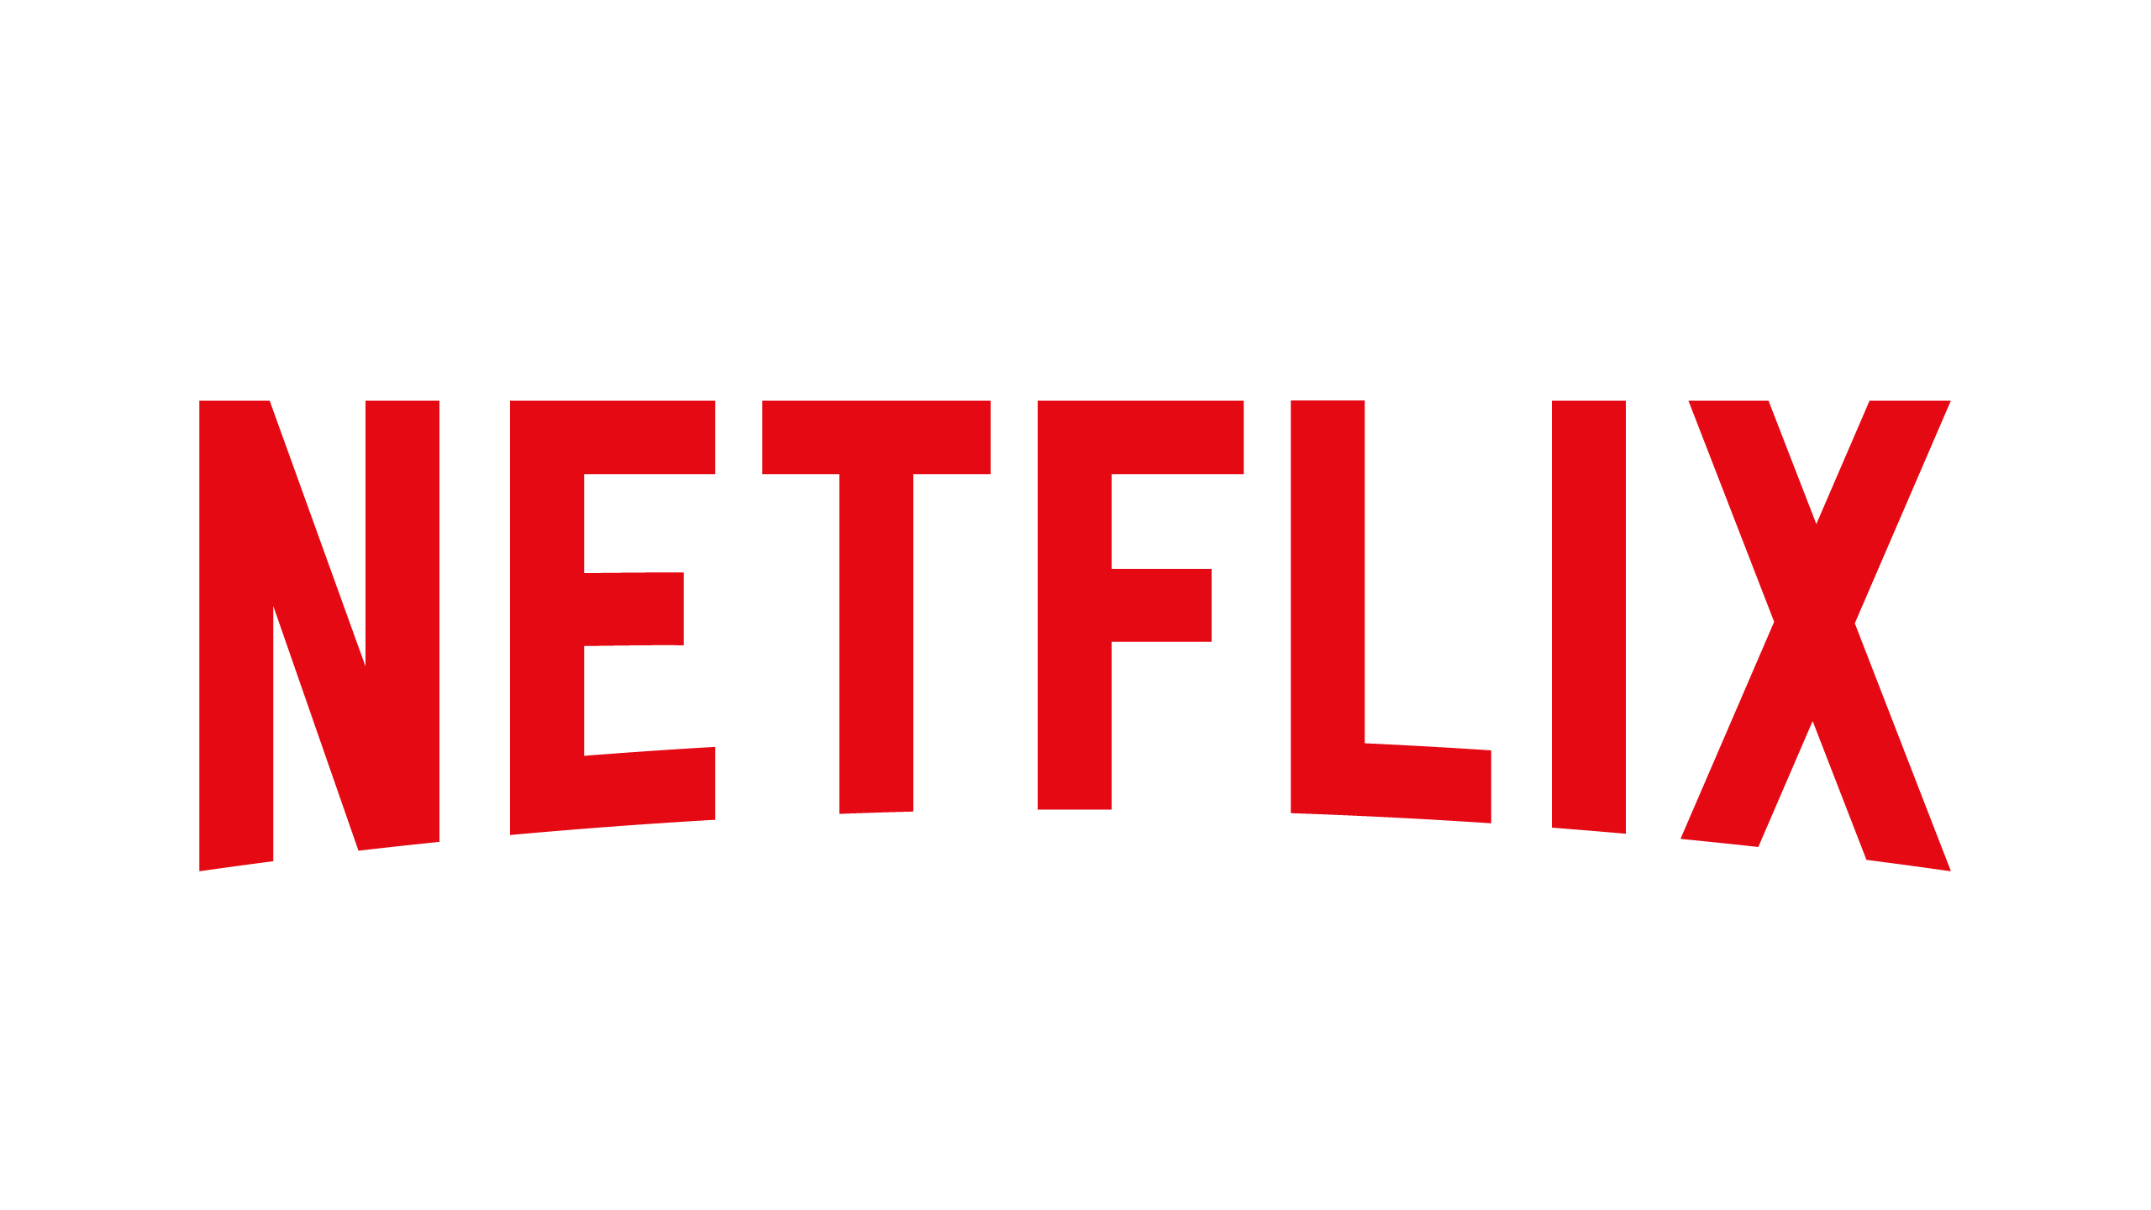
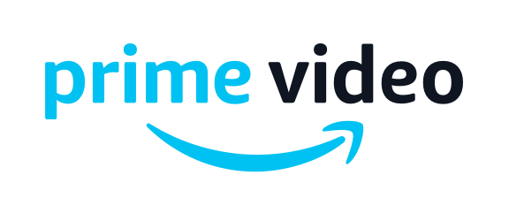
Competitive Intelligence
Netflix
vs.
Amazon Prime Video
Tatiksha Singh

Slide 2





Netflix Overview
Upcoming Deposits
$ 18.9 Billion
158.33 Million
Free Trial
30 Days
Basic
$8.99/Month
Revenue (TTM)
Total Worldwide Subscribers
(As of Q3 2019)
Standard
$12.99/Month
2018: 139.26 Million
Premium
$15.99/Month
Market Location
Movie/TV Show Content Spending
Video Quality
$15 Billion
Total Est. 2019
Basic
HD (480p max)
$12 Billion
Standard
Full HD (1080p max)
Total 2018
Premium
190+ Countries
Ultra HD (4K max)
SENTIMENT (Q3 2019) -10 SENTIMENT CHANGE +3
Notes:
Market Location Source: https://help.netflix.com/en/node/14164
“Netflix is not yet available in China, though the company continues to explore options for providing the service. It also is not available in Crimea, North Korea, or Syria due to U.S. government restrictions on American companies.”
# of Subscribers Source: https://www.statista.com/statistics/250934/quarterly-number-of-netflix-streaming-subscribers-worldwide/
Digital Entertainment (Market Cap) Source: https://research.alpha-sense.com/
Content Spending: https://variety.com/2019/digital/news/netflix-content-spending-2019-15-billion-1203112090/

Slide 3

Amazon Prime Video Overview
Upcoming Deposits
$ 2.8 Billion
96.5 Million
Free Trial
30 Days
Rent/Buy
Price Varies
2018 Annual Revenue
Total Worldwide Subscribers
(As of Q3 2019)
Prime Student₁
$6.49 ($59/Year)
2018: 50.23 Million
Prime₁
$12.99 ($119/Year)
Market Location
Movie/TV Show Content Spending
Video Quality
$7 Billion
Total Est. 2019
Highest Quality Possible (4K Max)
$1.7 Billion
Q1 2019
₁ Amazon Prime Video is included with Prime Membership
Non-Prime members can still watch Amazon Prime Video
Either by Renting or Paying from a selection of titles
200+ Countries
SENTIMENT (Q3 2019) -28 SENTIMENT CHANGE -26
Notes:
https://techcrunch.com/2019/08/22/hulu-and-amazon-prime-video-chip-away-at-netflixs-dominance/
https://www.adweek.com/tv-video/hulu-and-amazon-prime-video-are-gaining-on-netflix-in-the-streaming-wars/
https://www.statista.com/search/?q=amazon+prime+video+subscribers&qKat=newSearchFilter&sortMethod=idrelevance&isRegionPref=840&sortMethodMobile=idrelevance&statistics-group=1&statistics=1&forecasts=1&infos=1&topics=1&studies-reports=1&dossiers=1&groupA=1&xmo=1&surveys=1&toplists=1&groupB=1&branchreports=1&countryreports=1&groupC=1&expert-tools=1&cmo=1&dmo=1&mmo=1&co=1&accuracy=and&isoregion=0&isocountrySearch=&category=0&interval=0&archive=1
Sentiment Source (Sentiment is for Amazon overall; not specific to prime): https://research.alpha-sense.com/
Content Spending: https://www.cnbc.com/2019/03/08/amazon-prime-video-feature.html

Slide 4
Comparison Metrics
Metrics | Netflix | Amazon Prime Video
Price | Free Trial (30 days) $8.99 ($107.88/Year) $12.99 ($155.88‬/Year) $15.99 ($191.88‬/Year) No annual price offered Full access to movies/shows | Free Trial (30 days) Rent/Buy (Price Varies) $6.49 ($59/Year) $12.99 ($119/Year) Prime Video included with Prime Membership (as well as other Prime Benefits e.g. Prime Music) Without Prime Membership, movies/shows can be rented/purchased at varying prices
# of Streaming Devices | Basic — 1 stream only Standard — 2 simultaneous streams Premium — 4 simultaneous streams Once can stream the same program on 4 devices at once | Each Prime member can stream up to 3 devices at once But, one can only stream the same program on 2 devices at once
# Originals and Exclusives | 970 | 412
# Overall Content (Estimate- USA) | 4091 Movies 1761 TV Shows Total 5852 | 6400 Movies (Prime Eligible) 6400 TV Shows (Prime Eligible) Total 12,800
Extras | No ads | No ads Free streaming of Thursday Night Football
Notes:
https://www.finder.com/global-netflix-library-totals
https://www.amazon.com/Movies-Prime-Eligible-Video/s?i=instant-video&bbn=2858778011&rh=n%3A2858778011%2Cn%3A2864549011%2Cp_85%3A2470955011&dc&page=5&qid=1572808429&rnid=2858778011&ref=sr_pg_399

Slide 5
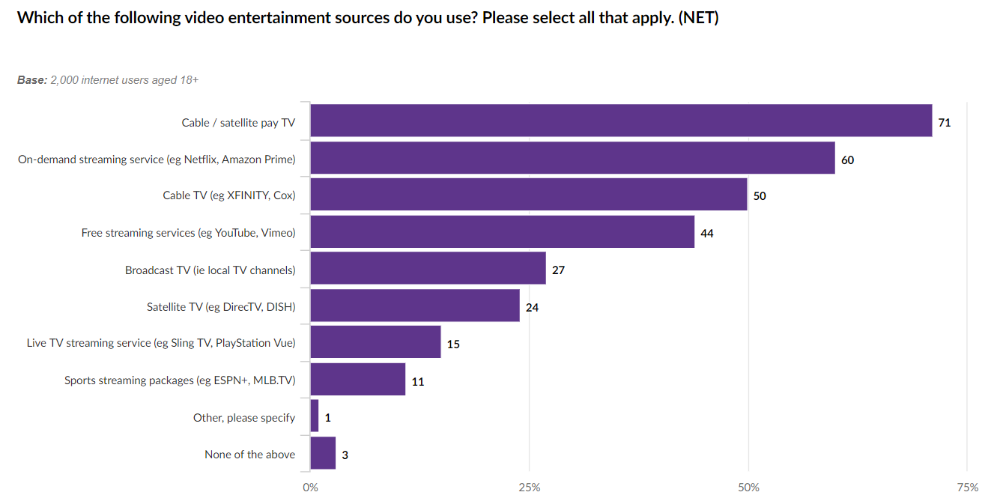
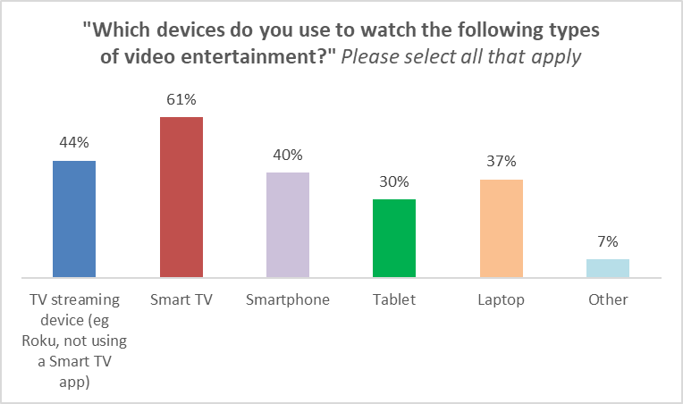
Digital Video Trends in US - June 2019
71% of consumers still use cable/ satellite pay TV for video entertainment
However, 60% of consumers also choose to use “On-demand streaming services” such as Netflix and Amazon Prime Video
From the 60% of users who watch ‘On-demand streaming services,’ the top 3 preferred sources were:
Smart TV (61%)
TV streaming device (44%)
Smartphones (40%)
https://www.statista.com/topics/842/netflix/
Notes:
Left Graph Source: https://data.mintel.com/databook/919388/#Q3a

Slide 6
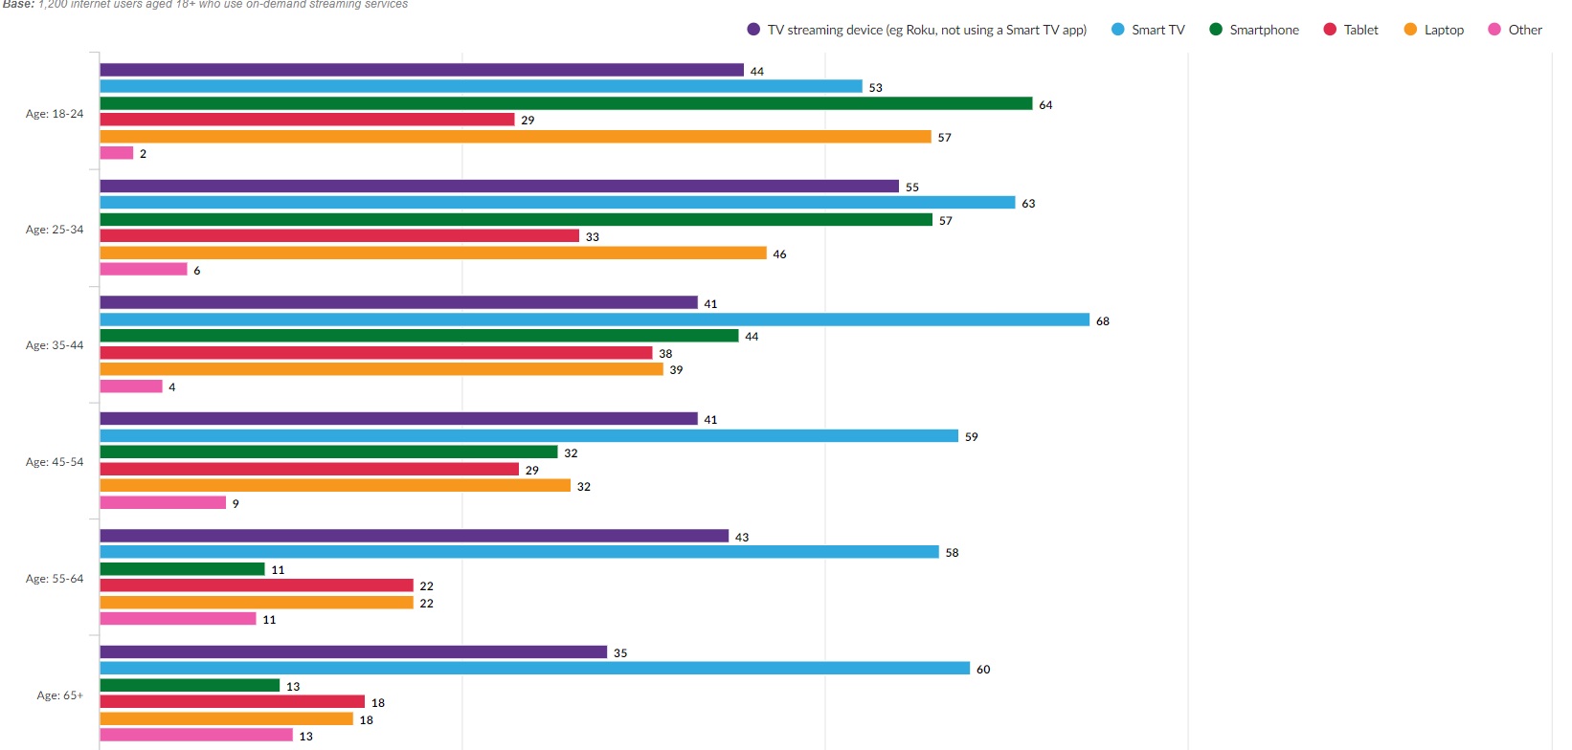
Demographic Trends in US - April 2019
Which devices do you use to watch the following types of video entertainment? Please select all that apply. On-demand streaming service (e.g. Netflix, Amazon Prime)
Base: 1,200 internet users aged 18+ who use on-demand streaming services
Key Insights:
64% of 18-24-year old’s prefer to stream movies and shows on Smartphones
The rest of the age groups preferred using Smart TVs to watch Netflix, Amazon Prime Video, Hulu, etc.
57% and 44% of 25-34-year old’s and 35-44-year old’s 2nd choice was streaming on smartphones
Both Males and Females across all age groups had the same preferences of watching online entertainment₁:
Smart TV
TV Streaming Device
Smart Phone
Laptop
Tablet
Other
₁ Appendix Fig 1
Notes:
Graph Source: https://data.mintel.com/databook/919388/question/Q2/group/1?d=gender&d=age&presentation=graphs

Slide 7
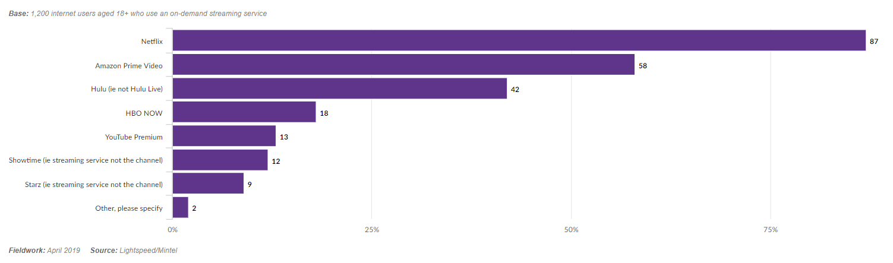
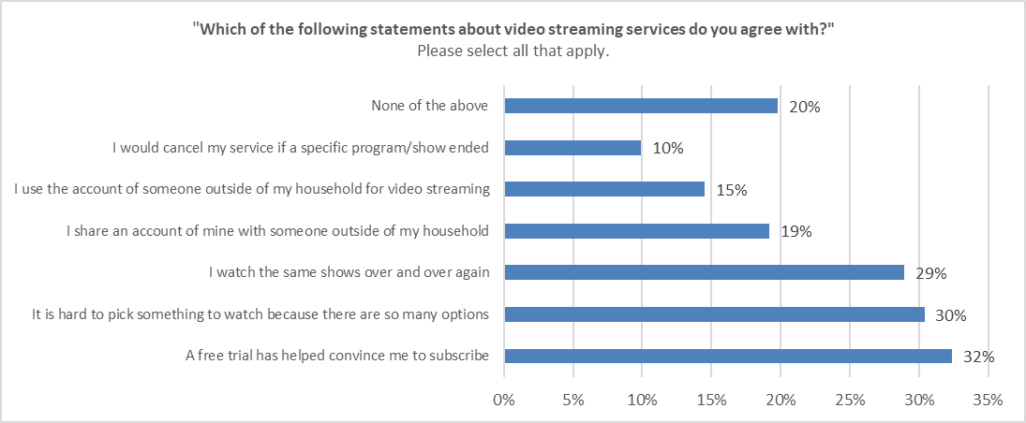
Digital Entertainment Preferences in US – April 2019
Key Insights:
87% of respondents preferred Netflix over Amazon Prime Video and other digital entertainment sources
Many people use free trials and are later convinced to subscribe after
30% find it overwhelming to choose a movie/show due to abundant options
29% of digital entertainment users like re-watching shows
Notes:
Data Source: (Top Graph): https://data.mintel.com/databook/919388/#Q3a
https://data.mintel.com/databook/919388/#Q4

Slide 8
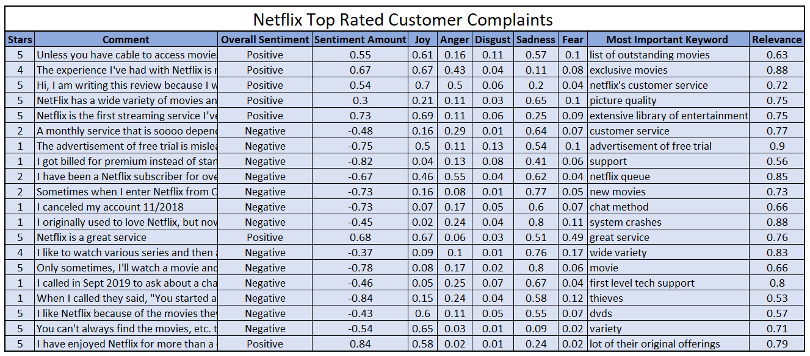
Netflix Sentiment Analysis
IBM Watson (Natural Language Understanding)
Notes:
https://www.consumeraffairs.com/entertainment/netflix.html?page=3#sort=top_reviews&filter=none
https://natural-language-understanding-demo.ng.bluemix.net/

Slide 9
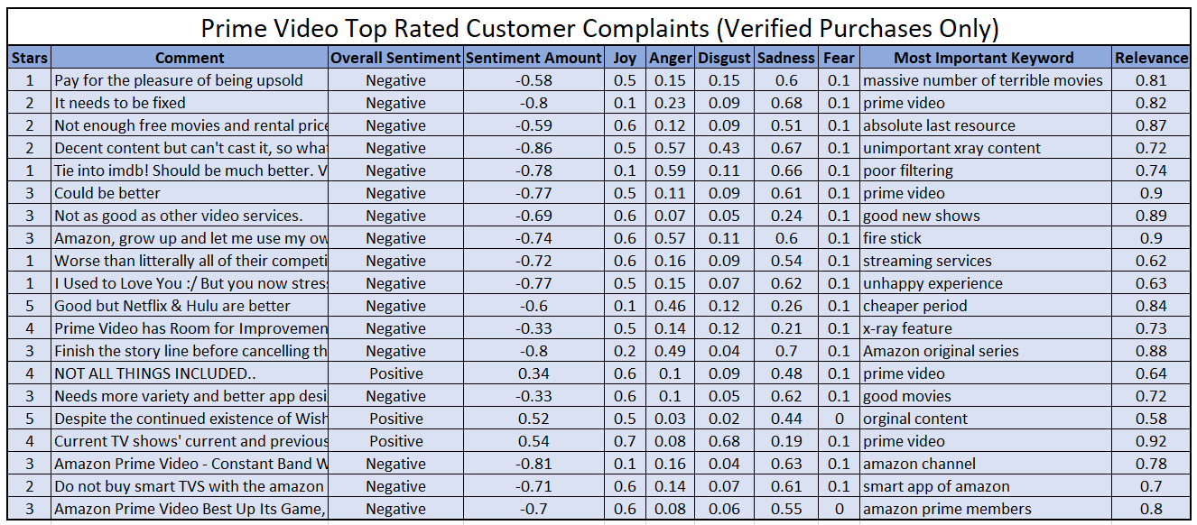
Prime Video Sentiment Analysis
IBM Watson (Natural Language Understanding)
Notes:
https://www.amazon.com/Amazon-com-Amazon-Prime-Video/product-reviews/B00N28818A/ref=cm_cr_arp_d_viewopt_rvwer?reviewerType=avp_only_reviews&filterByStar=one_star&pageNumber=1
https://natural-language-understanding-demo.ng.bluemix.net/

Slide 10
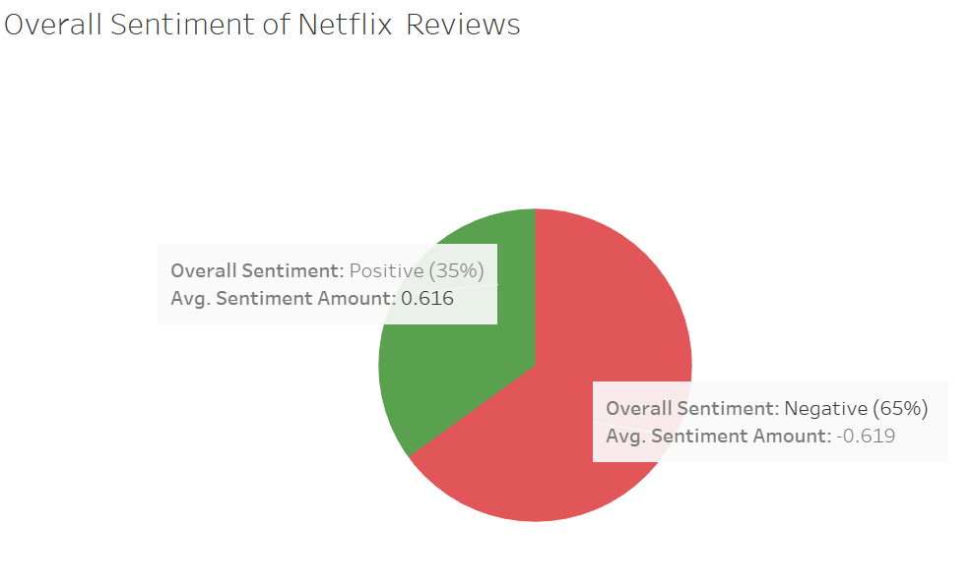
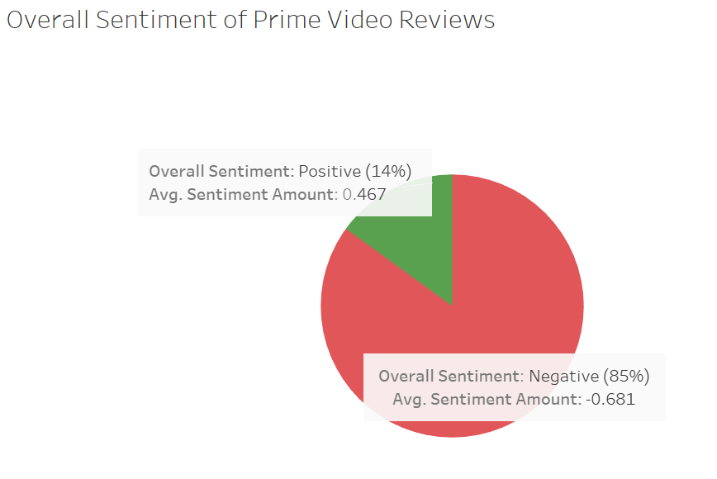
Sentiment Analysis of Netflix and Prime Video
Key Insights:
Prime had slightly fewer positive reviews compared to Netflix
Average sentiment amount was almost balanced for Netflix.
Prime had a higher average negative sentiment (-0.68) and lower average positive sentiment (0.47)
Most Prominent Keywords linked to a Negative Sentiment
Prime Video:
X-ray Feature
Bad Content (movies, shows)
Poor Filtering
Netflix:
Tech Support
Customer Service
Most Prominent Keywords linked to a Positive Sentiment
Prime Video:
Original Content
Netflix:
Extensive Library
Exclusive Movies (Originals)

Slide 11
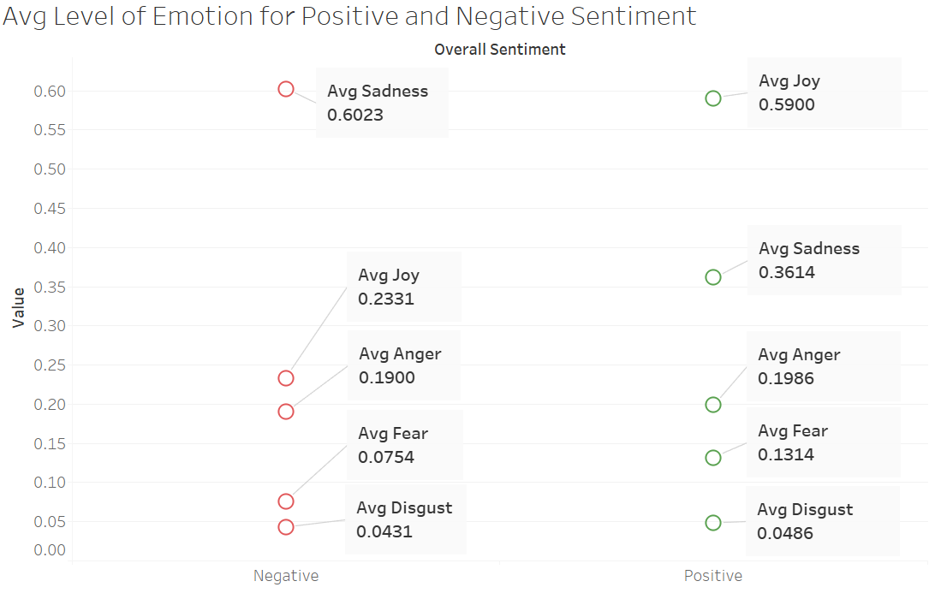
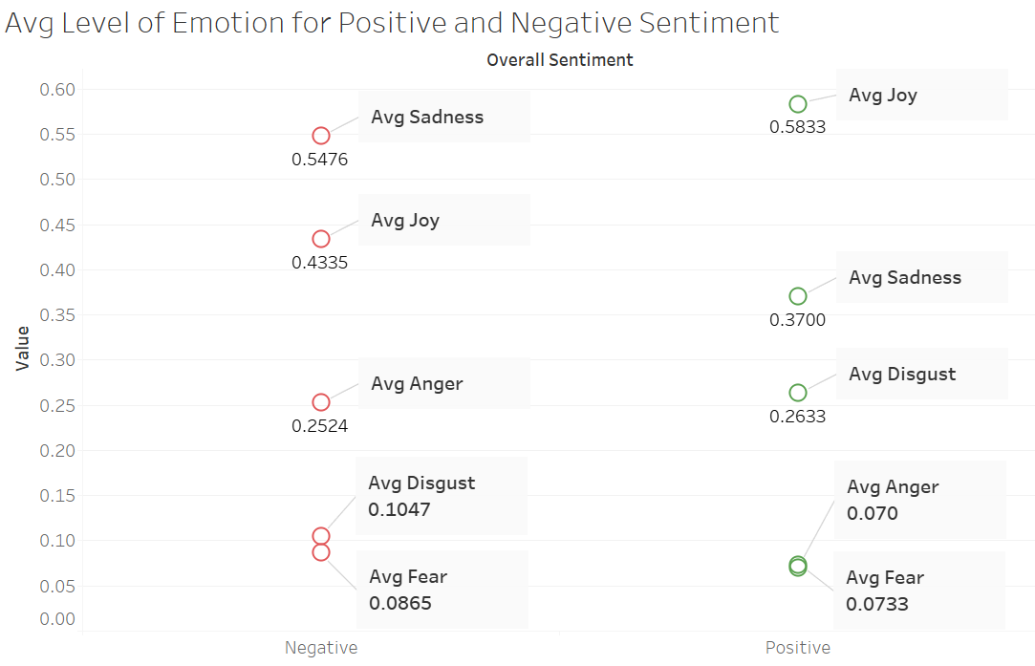
Overall Emotion Analysis of Netflix and Prime Video
Netflix
Prime Video
-Avg anger was similar for Positive and Negative Sentiment
-Users seemed to be more upset than angry when writing comments (seen with Prime Video as well)
-Both positive and negative sentiments showed low levels of avg disgust
-Netflix and Prime Video’s top negative sentiment emotion was sadness and top positive sentiment was joy
-Avg Joy was the 2nd highest emotion seen in negative sentiment comments
- Users complained about support, but still valued its library content
- Higher avg disgust (0.26) for Positive Sentiment compared to Negative (0.1047)
- Due to 1 Positive Review which had disgust value of 0.68 which skewed the results
- After examining the comment it showed no levels of disgust except for joy
- Avg Joy (0.43) for Negative Sentiment was higher than Avg Anger (0.25), Avg Disgust (0.10)
- Customers despite being upset about certain things, included some positive comments which caused level of ‘joy’ to be high

Slide 12
Key Takeaways
Both Prime Video and Netflix are spending vast amounts of money for tv show and movie content.
Netflix is spending almost twice as much as Prime Video
This extreme content investment is due to the rising streaming competition that is no longer Prime Video, but includes Hulu, Disney, Warner Media, NBC Universal, HBO now
Be wary when using IBM Watson – Natural Language Understanding (NLU) for emotion analysis
Results sometimes did not reflect correct emotion from content (e.g. customer reviews)
Quantity vs Quality Consideration
Prime Video offers significantly more TV Shows and Movies than Netflix, however many are considered ‘old’, ‘B-rated’ and unheard of
Netflix has had a drastic decline in # of movies offered, but has made up by offering vast ‘Netflix Originals’ that appeal to various audiences across different countries
Prime Video is competing by offering more original shows and movies (e.g. Jack Ryan, The Marvelous Mrs. Maisel, Fleabag, Red Oaks)
Recommendation system for Netflix helps with movie/show selection better than Prime, however, people still find it difficult to choose something due to extensive content
From demographics data (age and gender) both platforms must ensure UI/UX is meeting user’s standards across all age groups
Netflix is not doing as well as Prime Video to satisfy customer complains (they removed Customer Complaint page in 2018 since many were not using it)
No place for users to voice concerns/feedback
Inadequate customer service support
Moving Forward for Final Project- Hulu vs Netflix to consider additionally:
Conduct extensive social media analysis + Sentiment Analysis
Crawl Twitter [Tweet Deck], Acquire >1000 Customer Reviews to get a more representative sample
Comparison of Ad Spend for both platforms
Amazon Prime Video didn’t have any data, but Netflix does (so does Hulu) therefore, comparative analysis couldn’t be conducted
Calculate ROI, Costs (Ad Spender), Reach
Financial Analysis (might be difficult for Hulu since it is not public)

Slide 13
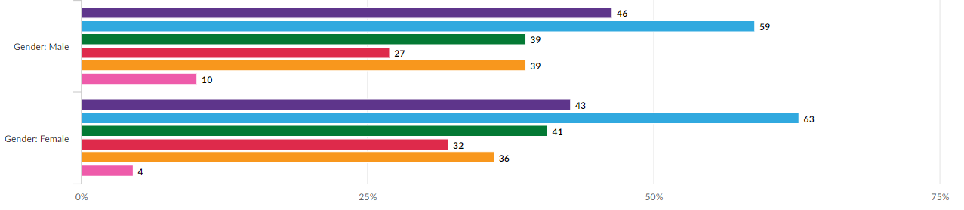
Appendix
Figure 1
Which devices do you use to watch the following types of video entertainment? Please select all that apply. On-demand streaming service (e.g. Netflix, Amazon Prime)
Base: 1,200 internet users aged 18+ who use on-demand streaming services
Source: https://data.mintel.com/databook/919388/question/Q2/group/1?d=gender&d=age&presentation=graphs&

Slide 14
Appendix
Data Sources Used
Alpha Sense
Netflix Website
Amazon Prime Video Website
Articles
Tech Websites (Variety, Tech Crunch)
IBM Watson – Natural Language Understanding
UCI Libraries
Ad Spender
Mintel
IBIS World
https://www.statista.com/statistics/250934/quarterly-number-of-netflix-streaming-subscribers-worldwide/
https://research.alpha-sense.com/
https://techcrunch.com/2019/08/22/hulu-and-amazon-prime-video-chip-away-at-netflixs-dominance/
https://www.adweek.com/tv-video/hulu-and-amazon-prime-video-are-gaining-on-netflix-in-the-streaming-wars/
https://www.finder.com/global-netflix-library-totals
https://www.amazon.com/Movies-Prime-Eligible-Video/s
http://adspender.kantarmediana.com/AdSpender/Pages/ReportViewer.aspx?.pl=HiddenReportViewer&action=ReportSummary&showback=1
https://www.consumeraffairs.com/entertainment/netflix.html?page=3#sort=top_reviews&filter=none
https://natural-language-understanding-demo.ng.bluemix.net/
https://www.emarketer.com/content/us-media-and-entertainment-digital-ad-spending-2019
https://www.androidauthority.com/amazon-prime-vs-netflix-1005748/
https://www.businessinsider.com/netflix-movie-catalog-size-has-gone-down-since-2010-2018-2

Slide 15
THANK YOU

Slide 16
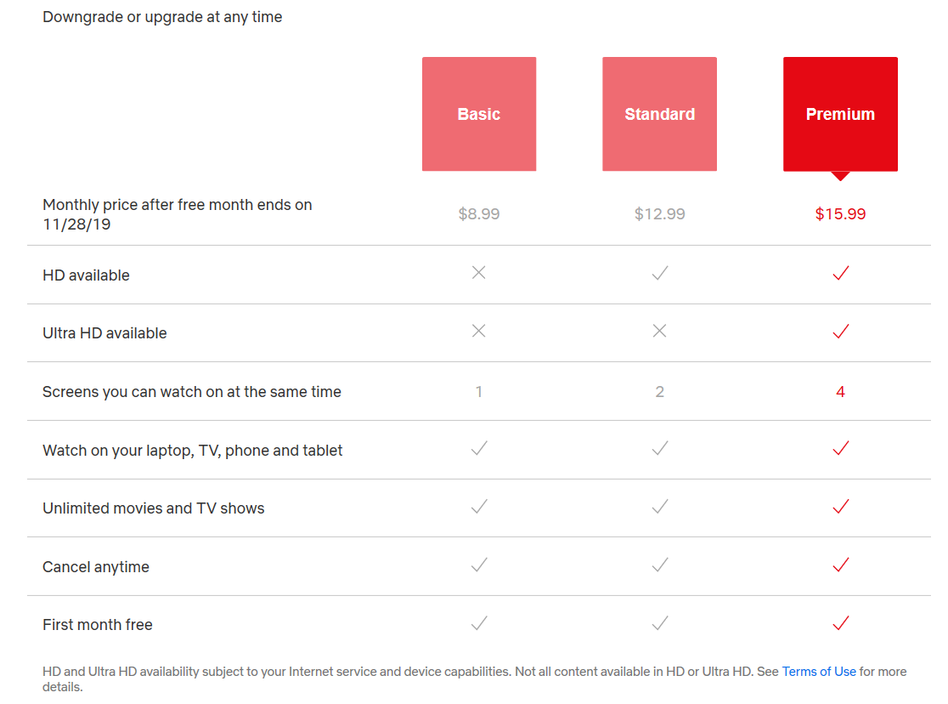
Appendix
Netflix Pricing Model

Slide 17
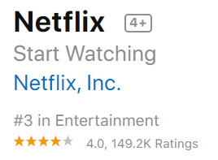
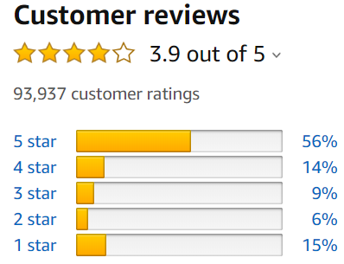

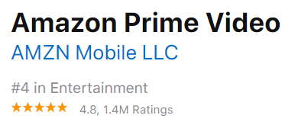


Slide 18
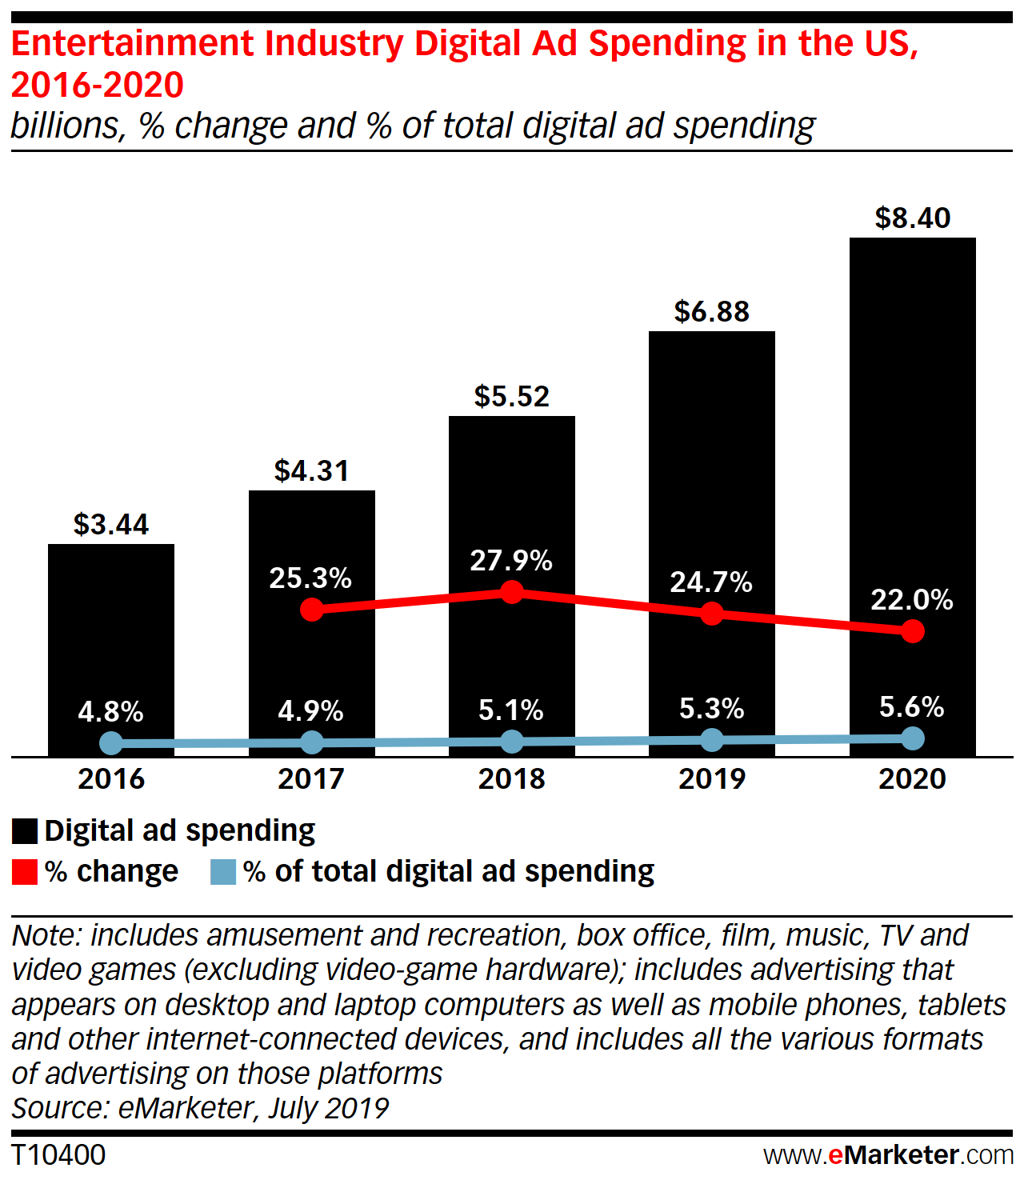
Ad Spending
Notes:
Entertainment Industry Digital Ad Image Source: https://www.emarketer.com/content/us-media-and-entertainment-digital-ad-spending-2019

Slide 19
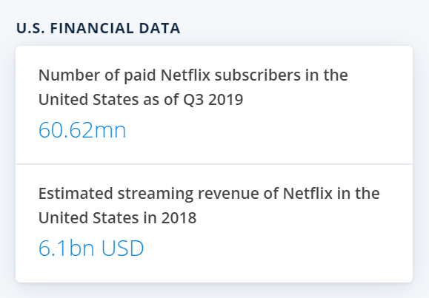
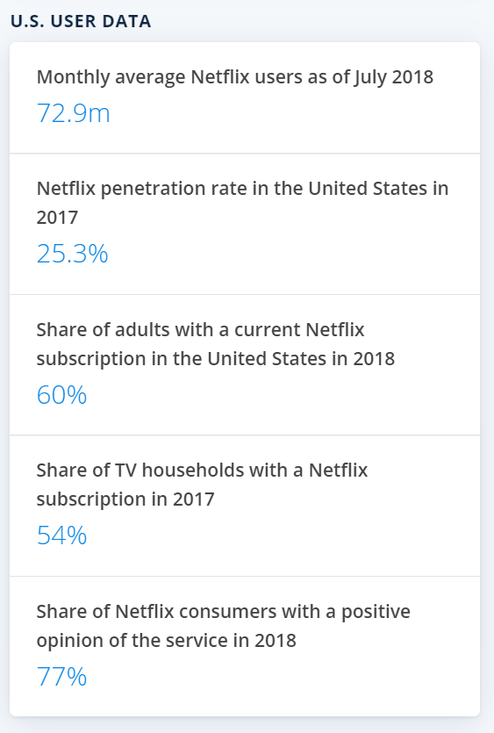
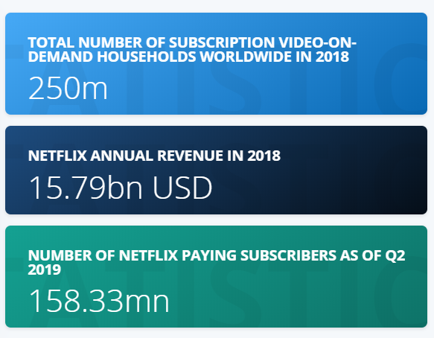
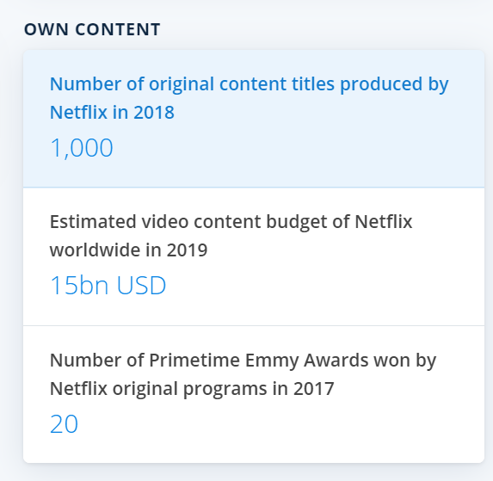

Slide 20
Price Comparison
Netflix | Amazon Prime Video
Free Trial (30 days) | Free Trial (30 days)
$8.99 ($107.88/Year) | Rent/Buy (Price Varies)
$12.99 ($155.88‬/Year) | $6.49 ($59/Year)
$15.99 ($191.88‬/Year) | $12.99 ($119/Year)
Netflix offers 3 plans paid monthly
No annual price offered
Full access to movies/shows with no ads
Varying quality of video depending on membership tier
Prime Video included with Prime Membership (as well as other Prime Benefits e.g. Prime Music)
Prime Membership offered monthly or annually (cheaper)
Without Prime Membership, movies/shows can be rented/purchased at varying prices
No ads
Stream in highest quality that your device supports
Overall consensus : Amazon Prime Video pricing tiers cost less than Netflix

Slide 21
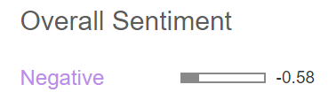
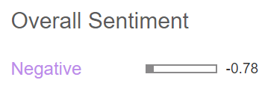
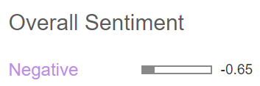
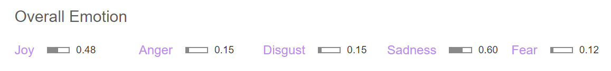
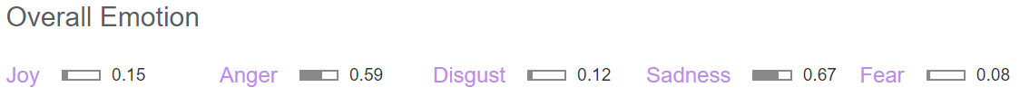


Prime Video Top Rated Customer Complaints
“If I'm paying $100 a year, I shouldn't have to pay for each movie I'm watching as well. Pick one or the other. The selection is terrible, and you have to sort through a massive number of terrible movies that are included for free and any remotely decent movies that you have to pay for. Every once in a while, I'll find a couple movies I like, but I have to sort though hundreds of movies I have never heard of, movies that are terrible, "tv shows" that are actually only 3 minutes long, etc. If you want to watch TV shows, that's also terrible...you can get full seasons of shows you like, and by that I mean you can get one random season and the rest you get to pay for...even though you are already paying for the service. It kind of feels like paying to test drive a car at a car lot.I have a Roku and every time (EVERY time) I load the app, I have to change the option to show me only items that are included in what I'm paying for. If I select a movie and then go back to the menu, it goes back to showing me content I have to pay for again. Prime video is just a service designed to nickle and dime its customers. Definitely would not recommend to anyone.”
“Update: the app stored over 5gb in a downloading folder. After deleting all videos and clearing all app data it still remained! Eating up 5gb of space for nothing! These are the kinds of bugs in Amazon's apps that have made me give up on them! I don't need to be wasting time tracking down these issues! I've uninstalled all Amazon apps from my devices and they run better for it! Sad Amazon! Very sad! I do not like this app at all, and it's the main reason I won't continue with Amazon videos. It doesn't tie into imdb's ratings -- Amazon owns both! When downloading videos it'll delete previous downloaded videos without warning, only allowed me to download 12 videos. Doesn't show audio language! Zoom doesn't stick when you pause etc... Poor filtering for movies -- would be nice to see by year or rating etc, instead of Amazon's "recommendations." Personally I'd be firing the team that developed this app.”
“I'm disgusted that I pay $99 annually for all the features of Amazon Prime, especially for free video streaming, but Amazon devalues me as a frequent customer by basically deciding that I can't view my Prime videos on the Lenovo Android tablet they just sold my boyfriend to give me for Christmas. After wasting 30 minutes of my life trying to jump through the hoops Amazon said would ultimately result in me being able to watch Prime videos, I find out that I still can't. Well that's a steaming pile of BS. After I watch the last set of shows in my queue on my PC or my eye-straining Android phone, I may have to end my Prime account and look for a modern less restrictive option. Amazon, you should treat all your Prime customers equally. All to sell a couple stupid Kindle Fires. Good luck with that.”
Notes:
https://www.amazon.com/Amazon-com-Amazon-Prime-Video/product-reviews/B00N28818A/ref=cm_cr_arp_d_viewopt_rvwer?reviewerType=avp_only_reviews&filterByStar=one_star&pageNumber=1

Slide 22
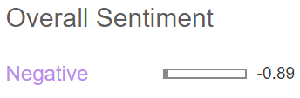
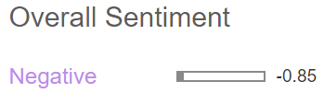

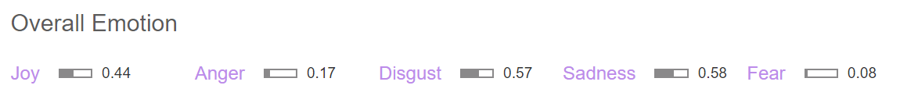
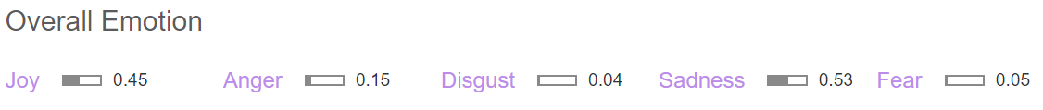

Netflix Top Rated Customer Complaints
“The advertisement of free trial is misleading and false. I previously had Netflix which I canceled 5 months ago. Once I saw the ad of free trial I clicked and entered my email address. Bear in mind I had looked for any tnc. There was no indication that it was only for first time user. I rejoined think it will be free for the first 30 days only to be surprised that I was charged.
Apparently the free trial is only for first time users and rejoiners of 10 months. Why is it not mentioned in the ads. And why is no one suing the company for such a misleading ads that's obviously meant to cheat people's money. What's worse is their airheaded, robotic, script repeating unsympathetic with zero eq help desk people with their complete lack of emotional response that just copy and paste their lack of transparent policies. Even if I enjoy their shows I do not want to associate with lying and cheating apps such as Netflix. It's corrupt and lack of moral. It's disgusting at such an Era we still have such organization that cheats so openly.”
“Do not download the app or sign up for Netflix. I've been having issues streaming Netflix for months yet paying for it. I've contacted customer service and they still don't solve the problem. It's obvious they have no knowledge about the app and zero will to help. When you ask for any alternatives, they tell you they will e-mail you the link to unsubscribe. Who does that?? I'm not sure if they underpay their representatives but nobody seems to care about helping with customer service. They are very nonchalant about it. It's a "go ahead, we don't need you attitude". Considering the competition out there, I'm not surprised people are switching to Hulu and Amazon. However, they don't care. Plus, they lack common sense. They don't train their customer service department in anything about the app that may help, they are clueless but the worst part is that they are extremely rude.”
“I canceled my account 11/2018. New charges showed up on card 9/2019 10/2019. I tried to do a log in with my old email and it did not work. I looked up my account with the card that is currently being charged and it would not show me an email. I started a conversation on the chat method on the website. They "changed the email back to mine", I asked them to just delete it, refund my money and tell me what email it was linked. The gentlemen Micheal told me via chat that he has no need to provide me that email, my card number was safe and he would only refund one month of the charge.
I called and spoke to a gentleman named Kim. He finally agreed to refund both months' charges after trying to get me off the phone several times. He told me "um no" and "there is no need to speak to a manager here", "you do not have the need", "I won't transfer you" when I repeatedly asked to speak to a manager. Now I have no worry about refunds taking up to 30 days, my issue is that my card was used when I did not give consent and the company would not help me in any way to help see who did or how the fraud occurred. Both methods of customer service was very rude and unwilling to help. I ended up hanging up the call because it ended up being a back and forth conversation about how he will not transfer me to a manager.”
Notes:
https://www.consumeraffairs.com/entertainment/netflix.html?#sort=top_reviews&filter=1

Slide 23
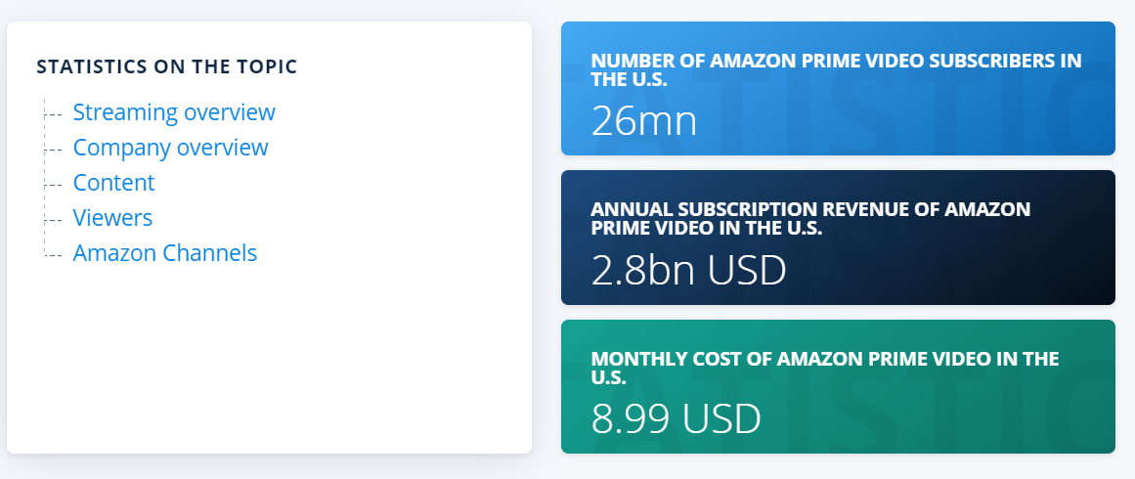

Slide 24
